Slide 1
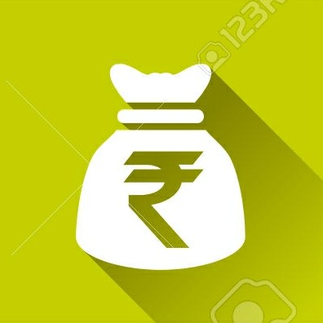
CHEDDAR STUDIO

Slide 2
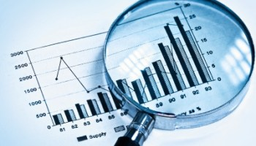
1. STOCK ANALYSIS
2. CURRENCY MAXIMIZER
3. BANK COMPARATOR
4. FINANCIAL GOAL CALCULATOR

Slide 3

A Splash screen was displayed in the beginning of the app.

Slide 4
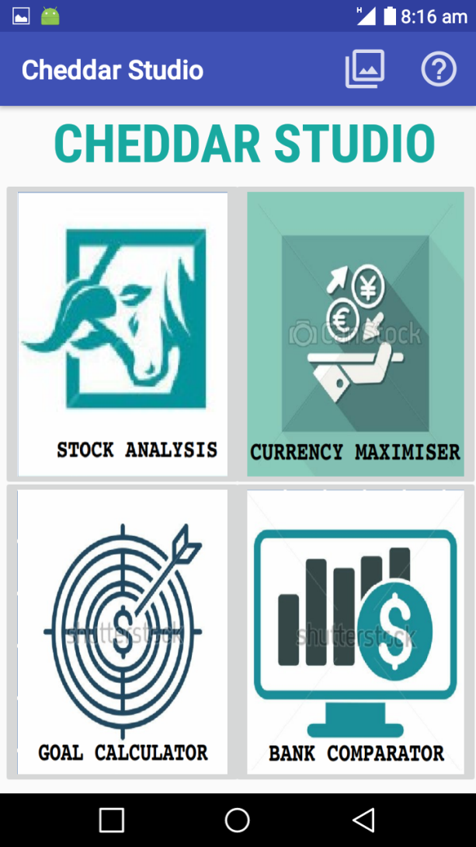
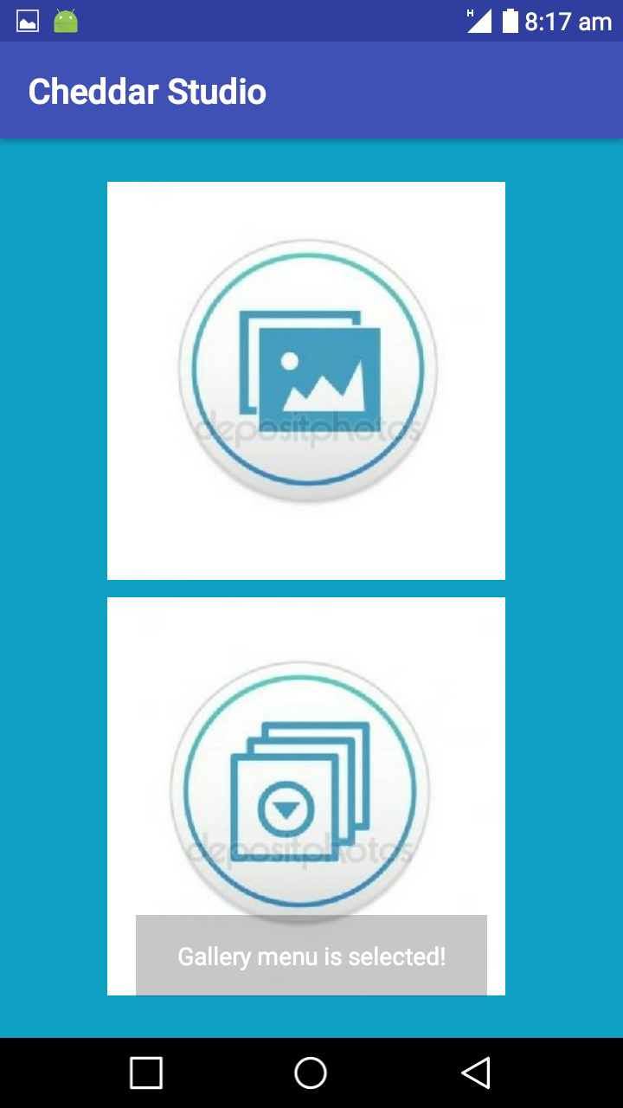
First Window
Gallery

Slide 5
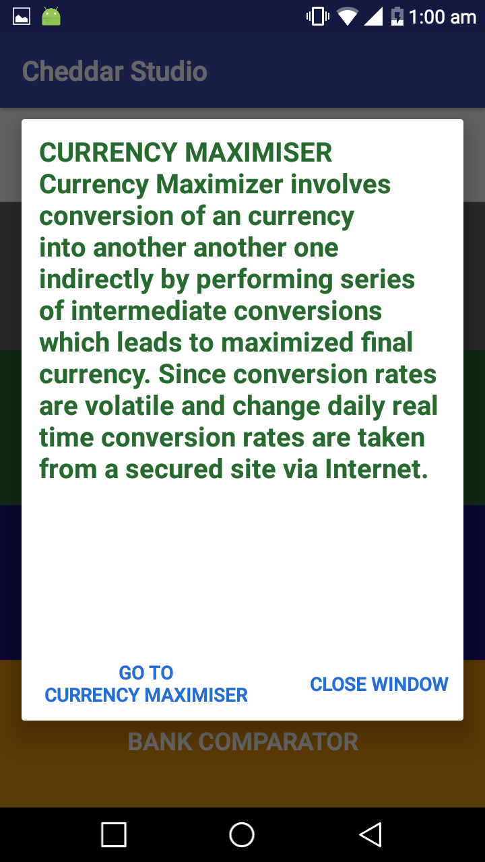
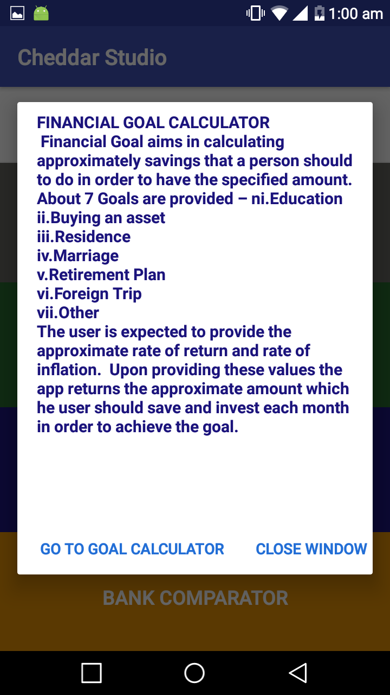
Guide

Slide 6
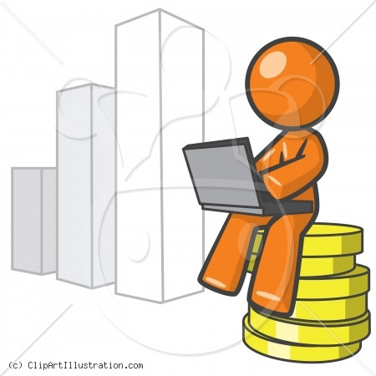
STOCK ANALYSIS
This module involves analyzing stocks of different companies and plotting them on Graph.

Slide 7
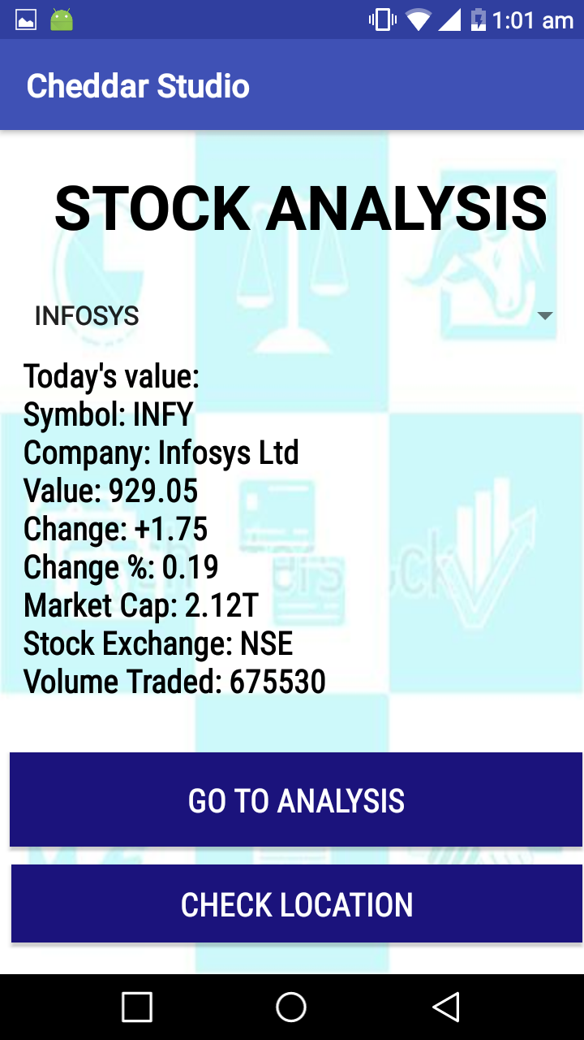
Stock Analysis

Slide 8
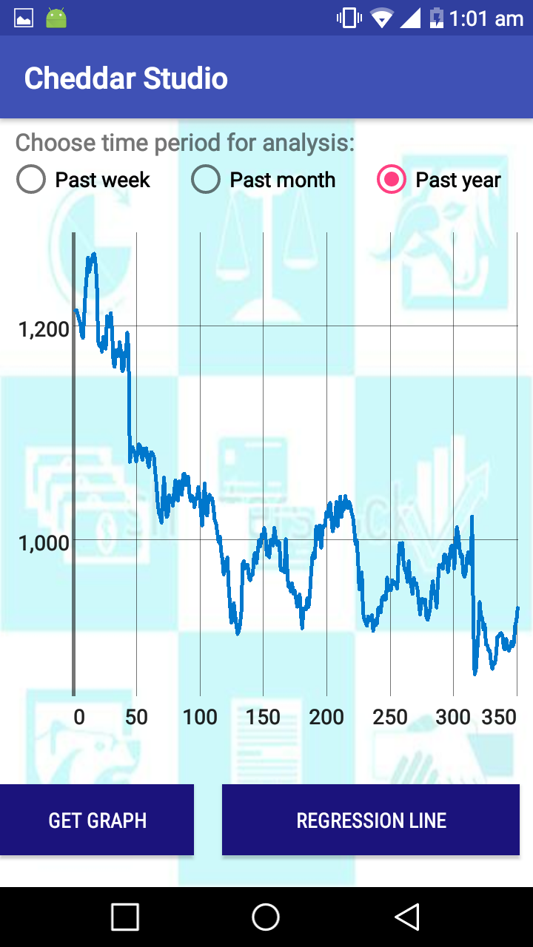
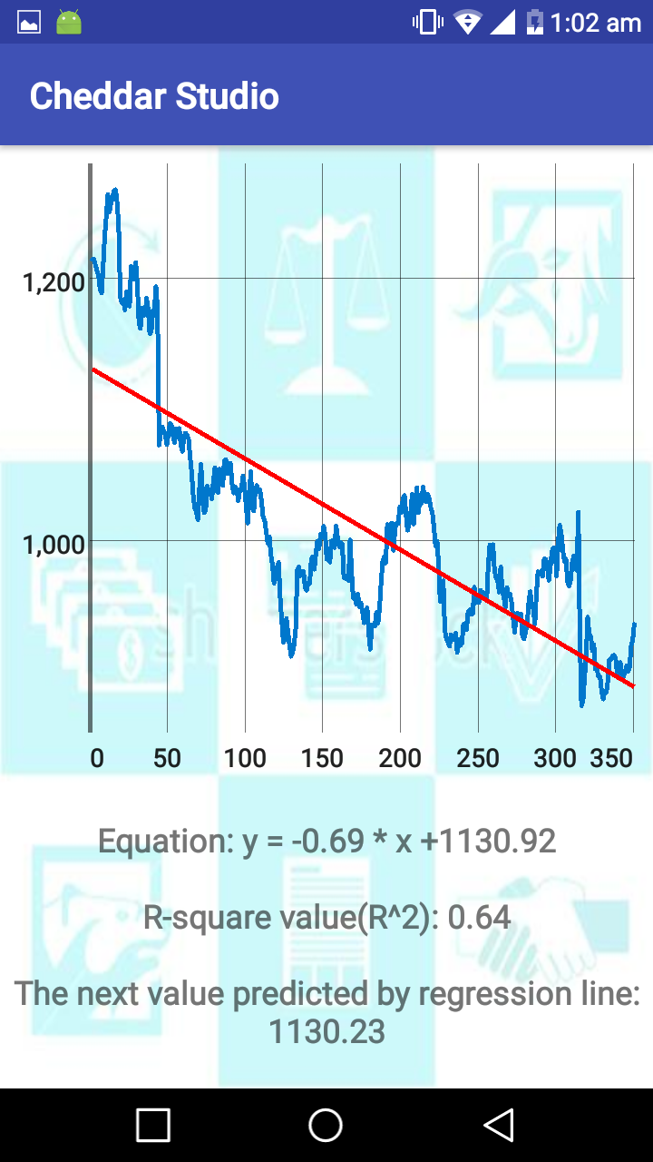

Slide 9
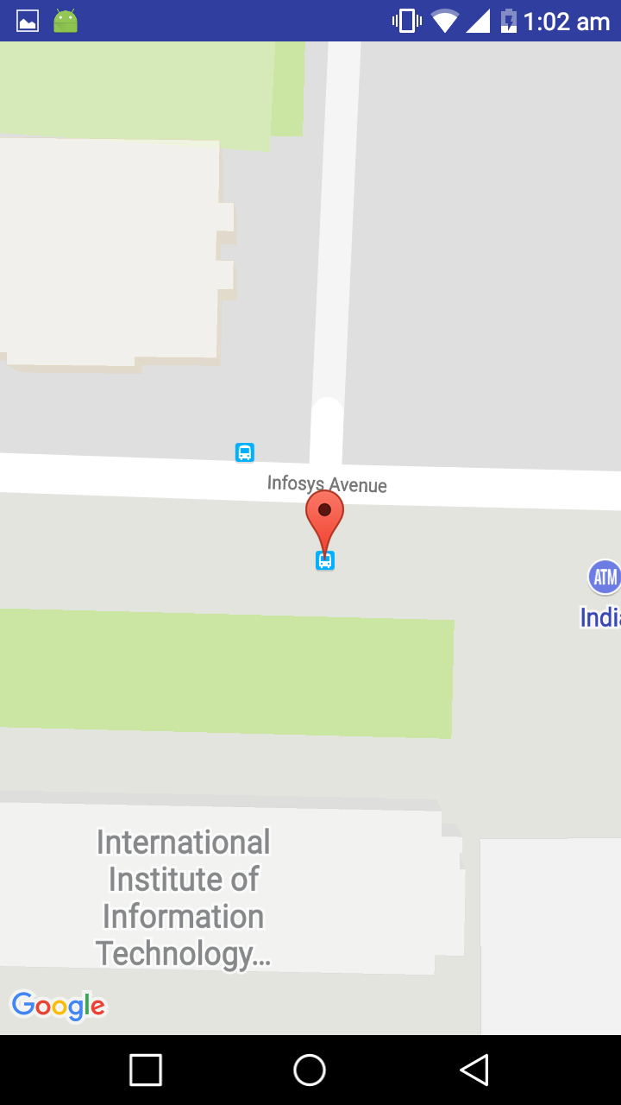
Location

Slide 10
The Graphs are plotted depending on time slots specified by the user. 3 time slots are available.
Hence, accordingly performance over a week, month or year can be analyzed

Slide 11

CURRENCY MAXIMIZER
Currency Maximizer involves conversion of an currency into another another one indirectly by performing series of intermediate conversions which leads to maximized final currency.

Slide 12
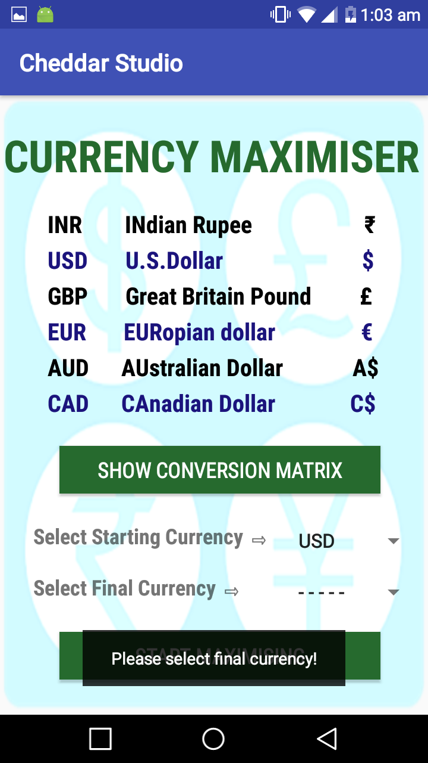
First Window

Slide 13
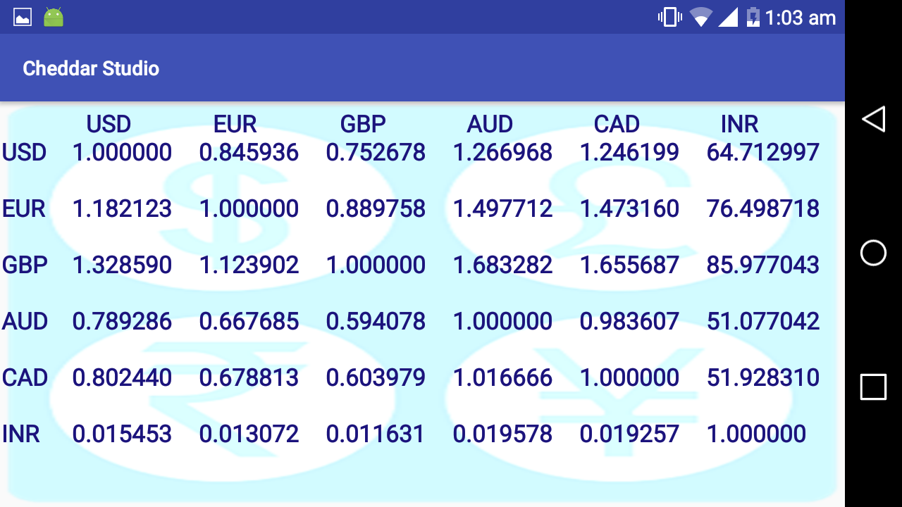
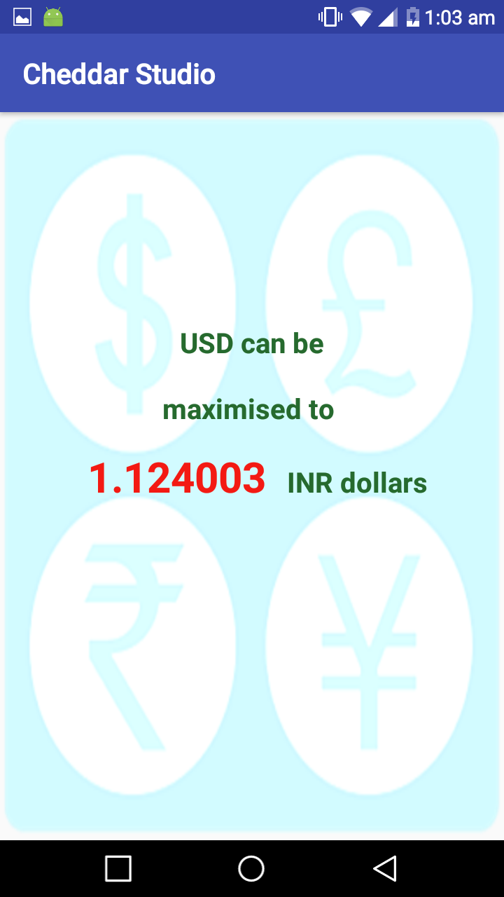

Slide 14
Since conversion rates are volatile and change daily real time conversion rates are taken from a secured site via Internet.

Slide 15
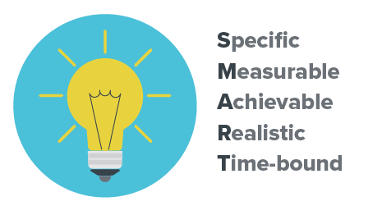
FINANCIAL GOAL CALCULATOR
Financial Goal aims in calculating approximately savings that a person should to do in order to have the specified amount.

Slide 16
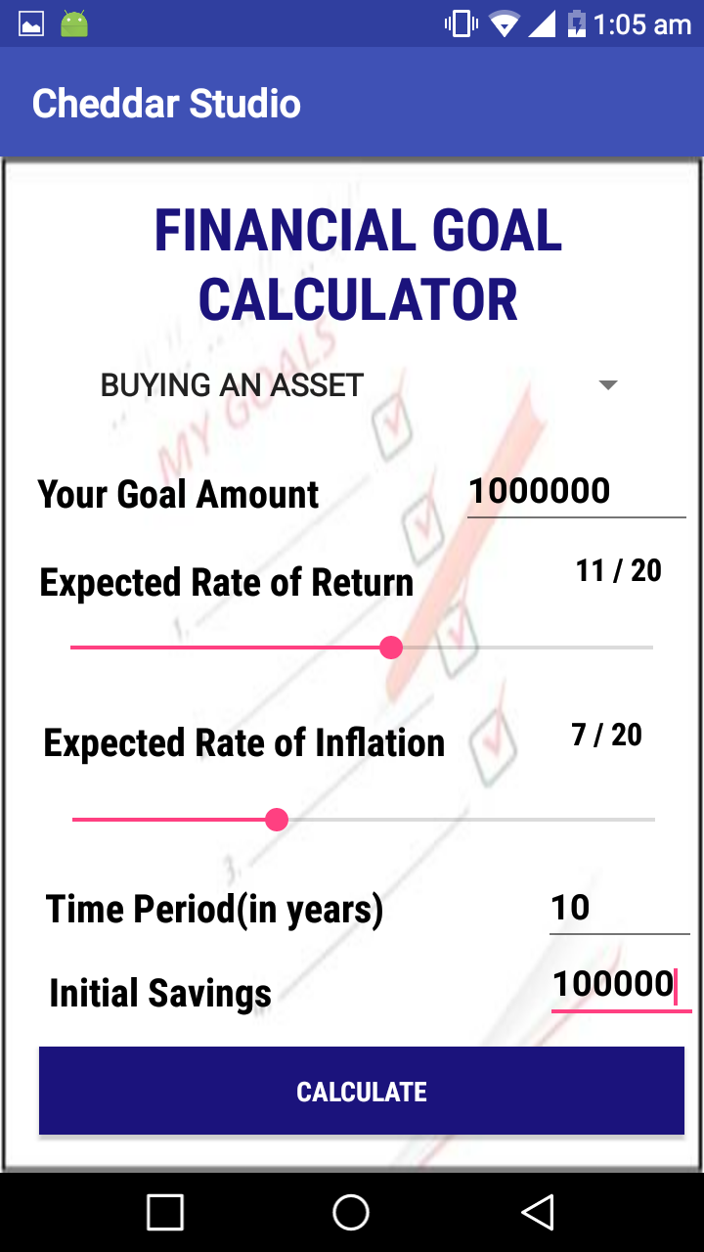
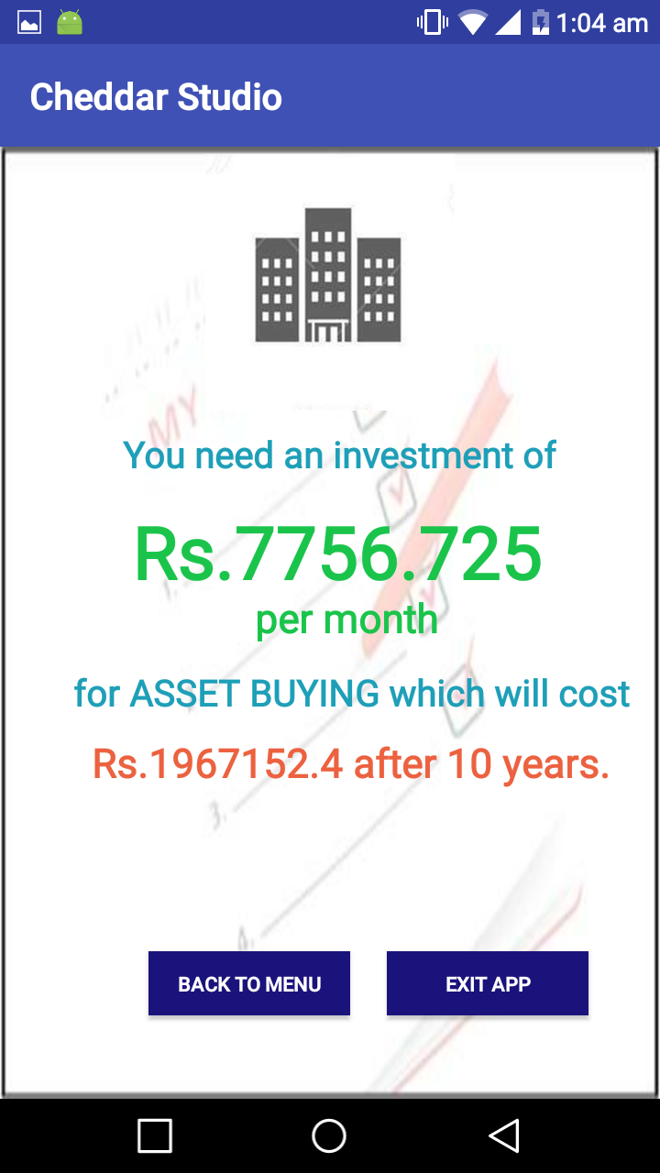

Slide 17
The user is expected to provide the approximate rate of return and rate of inflation. Upon providing these values the app returns the approximate amount which he user should save and invest each month in order to achieve the goal.

Slide 18
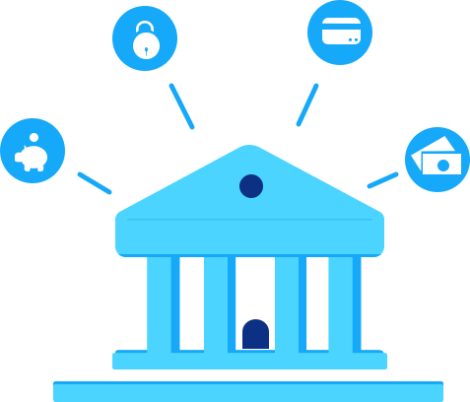
BANK COMPARATOR
This module involves comparing interest rates on FD and RD provided by different banks.
Initially the interest rates for Fixed Deposits and Recurring Deposits is displayed for each and every bank. Interest rates provided by Banks are time dependent

Slide 19
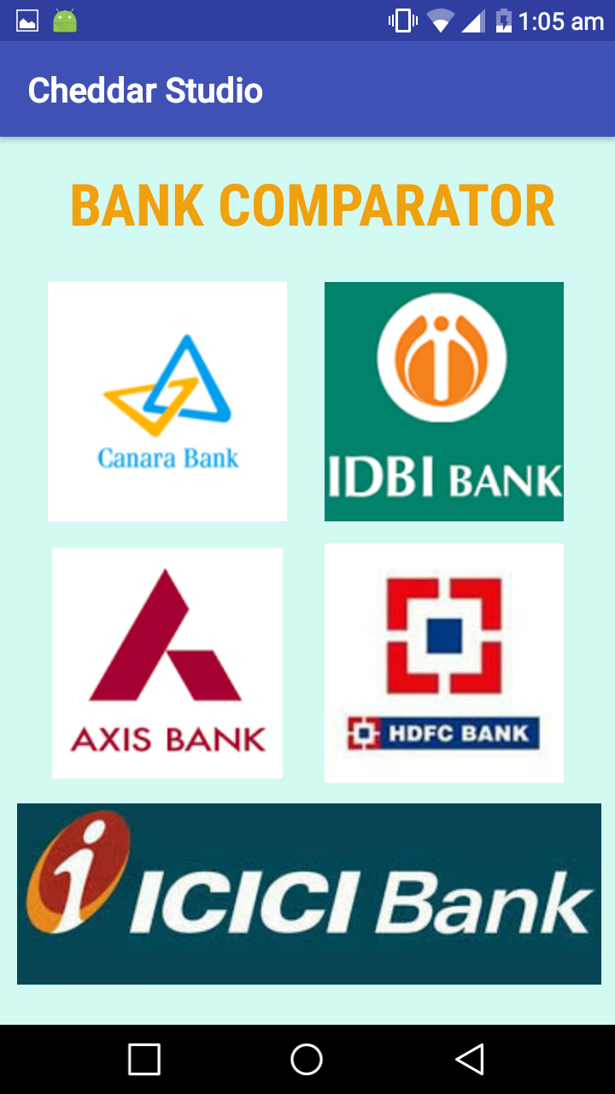
Bank Comparator

Slide 20
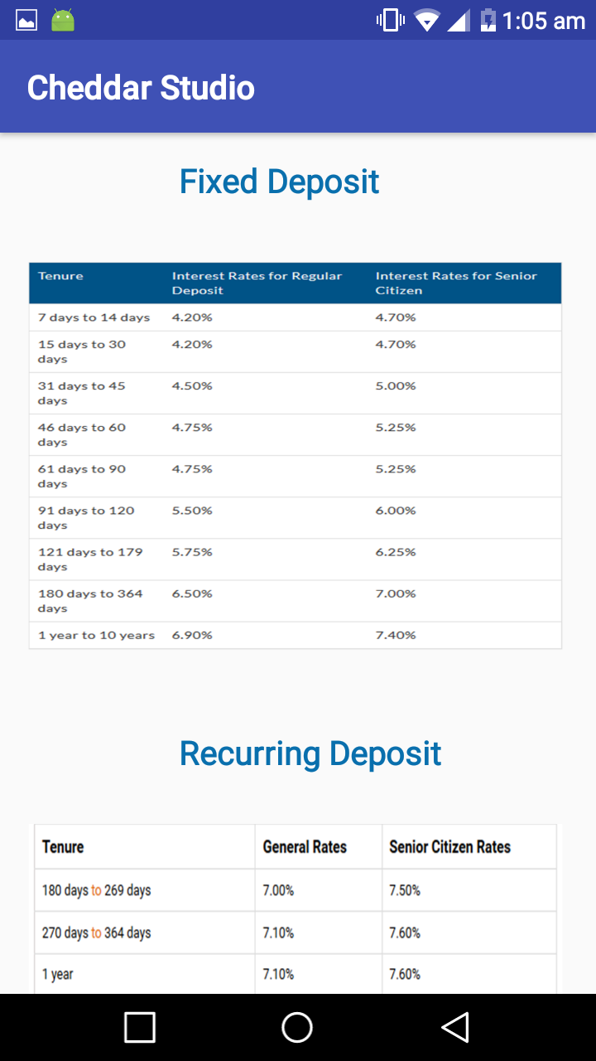

Slide 21

Key Features
Most of the data used in the modules are time dependent.
Hence taking static (hard coded) data was not taken.

Slide 22
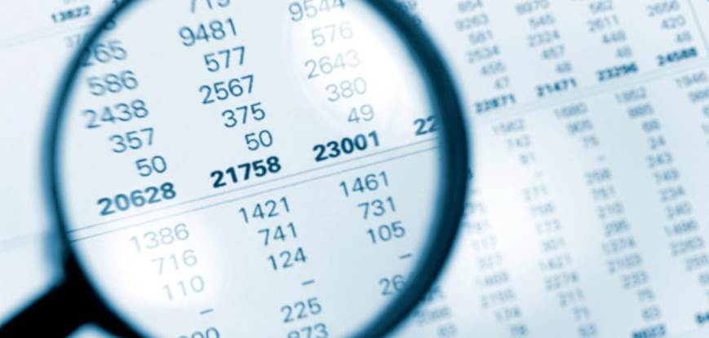
Instead real time data was taken from net
The database automatically gets updated as the values in real time change.
Graph View were used in Stock analysis module for giving a visual analysis of the stock.

Slide 23
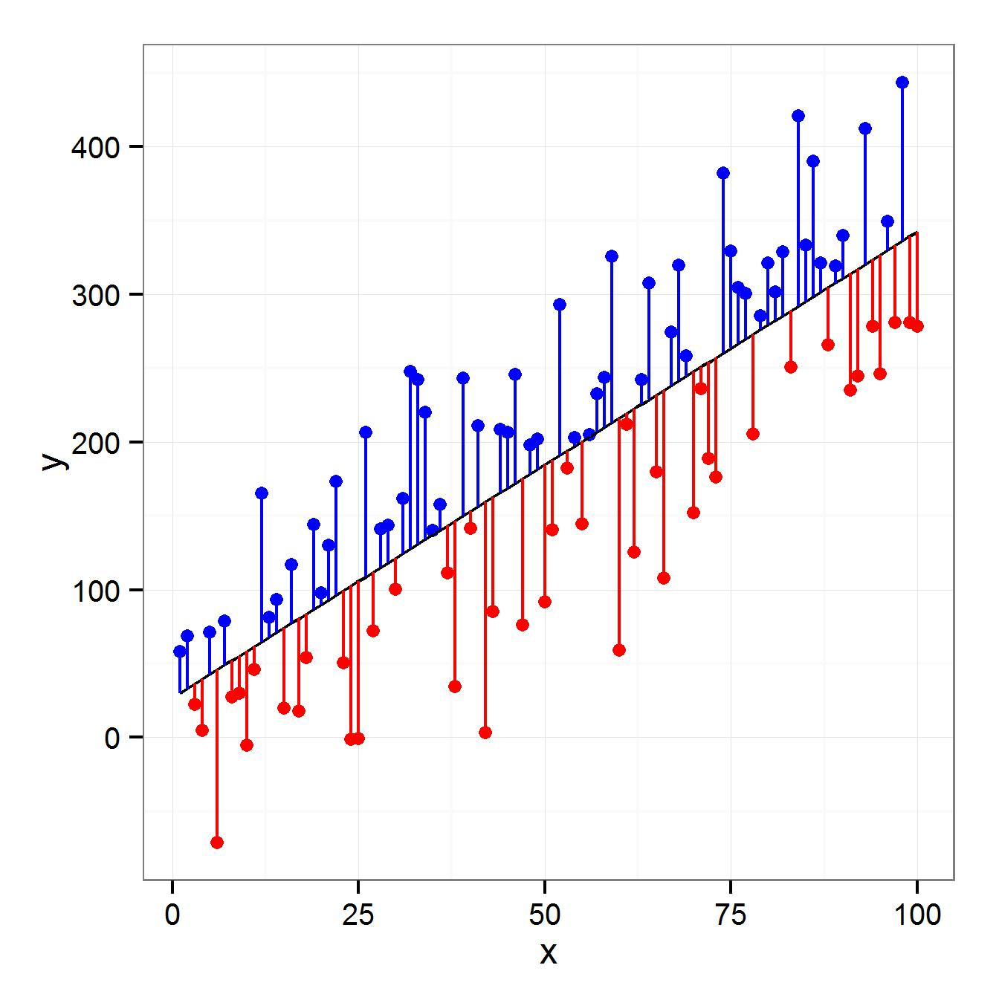
Machine Learning concept, Regression Lines were used to provide an approximate trend.
The line was plotted over multiple time periods.

Slide 25
THANK YOU !!!!

